Slide 1
For Live Session
Unit 7

Slide 2
For Live Session: Part 1 (3-5 hours)
In the last unit you used a KNN classifier to classify the passengers who survived and died. Now we will use a Naïve Bayes (NB) classifier and compare the two!
Using all 891 observations, train a NB model with Age and Pclass as predictors and use this model to predict the survival of a 30 year old passenger in the 1, 2 and 3 classes. Use the “type = raw” option to look at the predicted percentage of each outcome. (One slide.)
Split the 891 observations into a training and test set 70% - 30% using this seed and code:
titanicClean = titanic %>% filter(!is.na(Age) & !is.na(Pclass))
set.seed(4)
trainIndices = sample(seq(1:length(titanicClean$Age)),round(.7*length(titanicClean$Age)))
trainTitanic = titanicClean[trainIndices,]
testTitanic = titanicClean[-trainIndices,]
(One slide that shows the head of trainTitanic and testTitanic)
Train a NB model based on the training set using just the Age and Pclass variables. Use the model to predict the survival of those in the test set and use those results to evaluate the model based on accuracy, sensitivity and specificity. Finally, Compare the results to what you found with the KNN classifier. (At least one slide.)
Now repeat the above with a new seed and compare the accuracy, sensitivity and specificity. Do this 3 or 4 times to observe the variance in the statistics. (At least one slide.)
Write a loop to repeat the above for 100 different values of the seed. Find the average of the accuracy, sensitivity and specificity to get a stable (smaller variance) statistic to evaluate the model. (At least one slide.)

Slide 3
For Live Session: Part 1 (3-5 hours)
Now add Sex to the model so that it has Age, Pclass and Sex in the NB model. Use the trainTitanic(set.seed(4)) dataframe to train the model and create a confusion matrix using the testTitanic dataframe. In addition, find the Accuracy, Sensitivity and Specificity. (1 slide)
Again write a loop to get a stable estimate of the accuracy, sensitivity and specificity of this model (using 100 unique seeds). (1 slide)
BONUS: Using the Male and Female KNN from the bonus of Unit 6, combine the two confusion matrices from the Male and Female KNN models to make one confusion matrix and find the accuracy, sensitivity and specificity based on that model. Compare this with the performance of your NB model. Do you prefer one over the other?

Slide 4
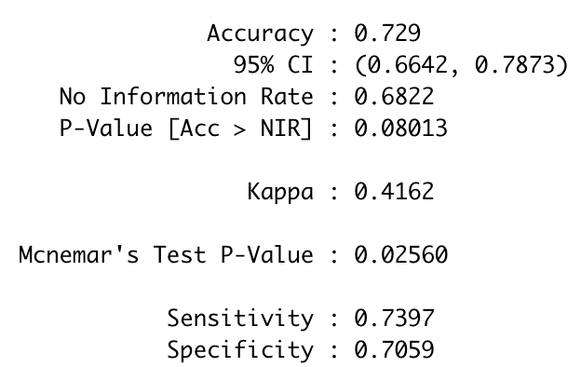
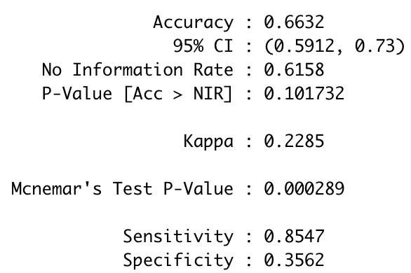
For Live Session: Part 1 (3-5 hours)
Train a NB model based on the training set using just the Age and Pclass variables. Use the model to predict the survival of those in the test set and use those results to evaluate the model based on accuracy, sensitivity and specificity. Finally, Compare the results to what you found with the KNN classifier. (At least one slide.)
NB Classifier
#Note: naiveBayes() requires the response variable to be a factor … Survived is an integer (0,1).
model = naiveBayes(trainTitanic[,c("Age","Pclass")],factor(trainTitanic$Survived, labels = c("No", "Yes")))
table(factor(testTitanic$Survived, labels = c("No", "Yes")),predict(model,testTitanic[,c("Age","Pclass")]))
CM = confusionMatrix(table(factor(testTitanic$Survived, labels = c("No", "Yes")),predict(model,testTitanic[,c("Age","Pclass")])))
CM
KNN Classifier (k = 11)
classifications = knn(trainTitanic[(!is.na(trainTitanic$Age) & !is.na(trainTitanic$Pclass)),c(3,6)],testTitanic[(!is.na(testTitanic$Age) & !is.na(testTitanic$Pclass)),c(3,6)],trainTitanic$Survived[(!is.na(trainTitanic$Age) & !is.na(trainTitanic$Pclass))], prob = TRUE, k = 11)
CM = confusionMatrix(table(classifications,testTitanic$Survived[(!is.na(testTitanic$Age) & !is.na(testTitanic$Pclass))]))
CM

Slide 5
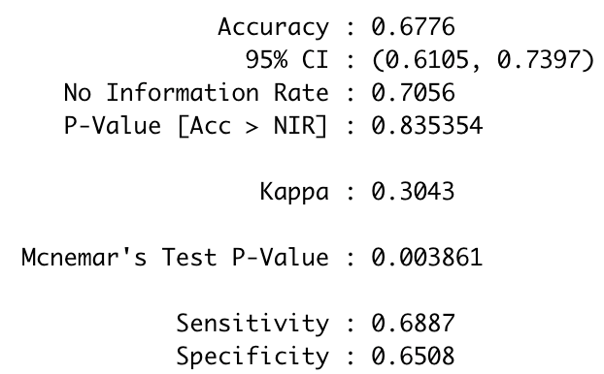
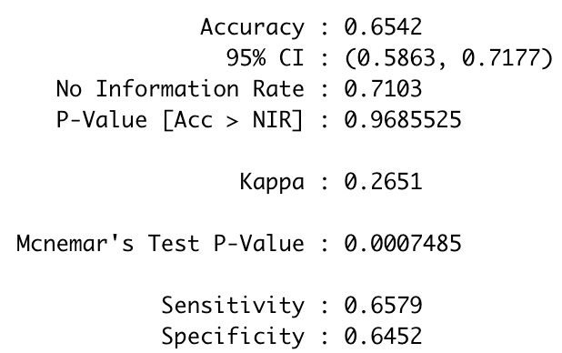
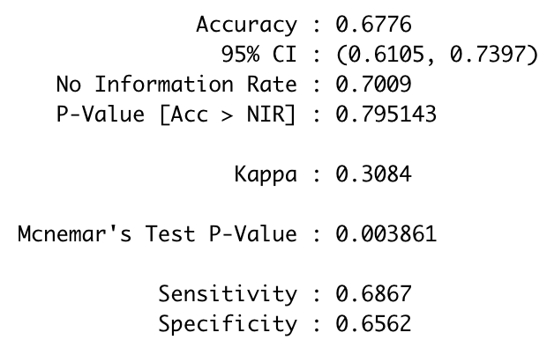
For Live Session: Part 1 (3-5 hours)
Now repeat the above with a new seed and compare the accuracy, sensitivity and specificity. Do this 3 or 4 times to observe the variance in the statistics. (At least one slide.)
set.seed(4)
set.seed(5)
set.seed(6)
set.seed(7)
set.seed(7). # just change the seed number and then run the code to see the variance in the accuracy, specificity and sensitivity
trainIndices = sample(seq(1:length(titanicClean$Age)),round(.7*length(titanicClean$Age)))
trainTitanic = titanicClean[trainIndices,]
testTitanic = titanicClean[-trainIndices,]
model = naiveBayes(trainTitanic[,c("Age","Pclass")],factor(trainTitanic$Survived, labels = c("No", "Yes")))
table(factor(testTitanic$Survived, labels = c("No", "Yes")),predict(model,testTitanic[,c("Age","Pclass")]))
CM = confusionMatrix(table(factor(testTitanic$Survived, labels = c("No", "Yes")),predict(model,testTitanic[,c("Age","Pclass")])))
CM

Slide 6
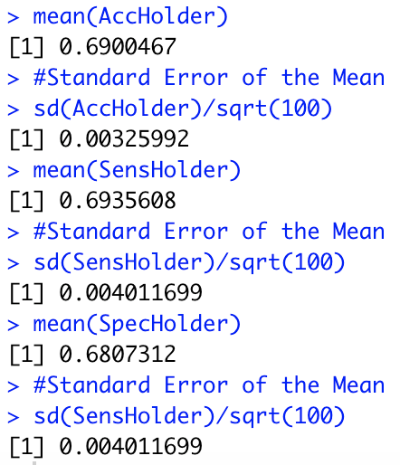
For Live Session: Part 1 (3-5 hours)
In the last unit you used a KNN classifier to classify the passengers who survived and died. Now we will use a Naïve Bayes (NB) classifier and compare the two!
Write a loop to repeat the above for 100 different values of the seed. Find the average of the accuracy, sensitivity and specificity to get a stable (smaller variance) statistic to evaluate the model. (At least one slide.)
AccHolder = numeric(100)
SensHolder = numeric(100)
SpecHolder = numeric(100)
for (seed in 1:100)
{
set.seed(seed)
trainIndices = sample(seq(1:length(titanicClean$Age)),round(.7*length(titanicClean$Age)))
trainTitanic = titanicClean[trainIndices,]
testTitanic = titanicClean[-trainIndices,]
model = naiveBayes(trainTitanic[,c("Age","Pclass")],factor(trainTitanic$Survived, labels = c("No", "Yes")))
table(factor(testTitanic$Survived, labels = c("No", "Yes")),predict(model,testTitanic[,c("Age","Pclass")]))
CM = confusionMatrix(table(factor(testTitanic$Survived, labels = c("No", "Yes")),predict(model,testTitanic[,c("Age","Pclass")])))
AccHolder[seed] = CM$overall[1]
SensHolder[seed] = CM$byClass[1]
SpecHolder[seed] = CM$byClass[2]
}
mean(AccHolder)
sd(AccHolder)
mean(SensHolder)
sd(SensHolder)
mean(SpecHolder)
sd(SensHolder)

Slide 7
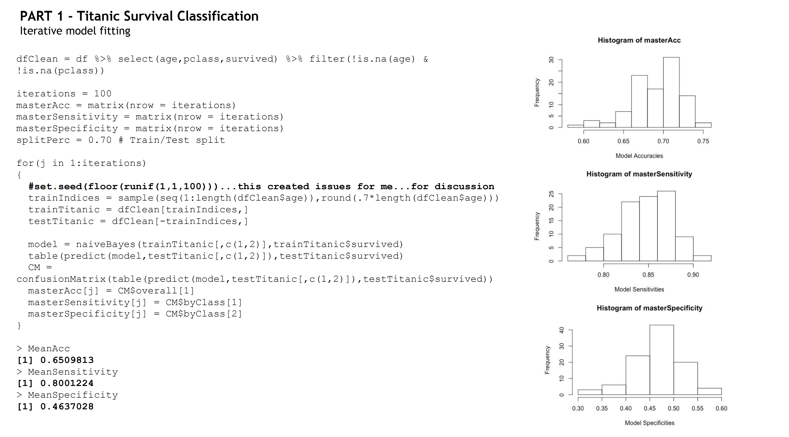

Slide 8
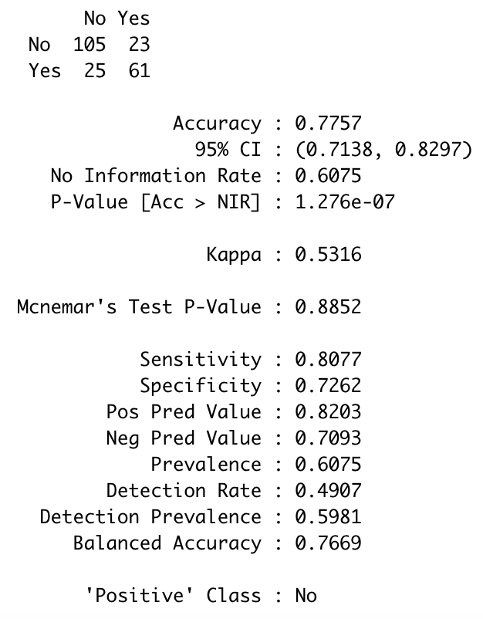
For Live Session: Part 1 (3-5 hours)
Now add Sex to the model so that it has Age, Pclass and Sex in the NB model. Use the trainTitanic(set.seed(4)) dataframe to train the model and create a confusion matrix using the testTitanic dataframe. In addition, find the Accuracy, Sensitivity and Specificity. (1 slide)
#seed = 4
model = naiveBayes(trainTitanic[,c("Sex","Age","Pclass")],factor(trainTitanic$Survived, labels = c("No", "Yes")))
CM = confusionMatrix(table(factor(testTitanic$Survived, labels = c("No", "Yes")),predict(model,testTitanic[,c("Sex","Age","Pclass")])))

Slide 9
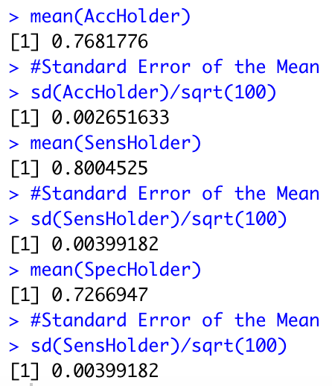
For Live Session: Part 1 (3-5 hours)
Again write a loop to get a stable estimate of the accuracy, sensitivity and specificity of this model (using 100 unique seeds). (1 slide)
AccHolder = numeric(100)
SensHolder = numeric(100)
SpecHolder = numeric(100)
for (seed in 1:100)
{
set.seed(seed)
trainIndices = sample(seq(1:length(titanicClean$Age)),round(.7*length(titanicClean$Age)))
trainTitanic = titanicClean[trainIndices,]
testTitanic = titanicClean[-trainIndices,]
model = naiveBayes(trainTitanic[,c("Sex","Age","Pclass")],factor(trainTitanic$Survived, labels = c("No", "Yes")))
CM = confusionMatrix(table(factor(testTitanic$Survived, labels = c("No", "Yes")),predict(model,testTitanic[,c("Sex","Age","Pclass")])))
AccHolder[seed] = CM$overall[1]
SensHolder[seed] = CM$byClass[1]
SpecHolder[seed] = CM$byClass[2]
}
mean(AccHolder)
sd(AccHolder)
mean(SensHolder)
sd(SensHolder)
mean(SpecHolder)
sd(SensHolder)

Slide 10
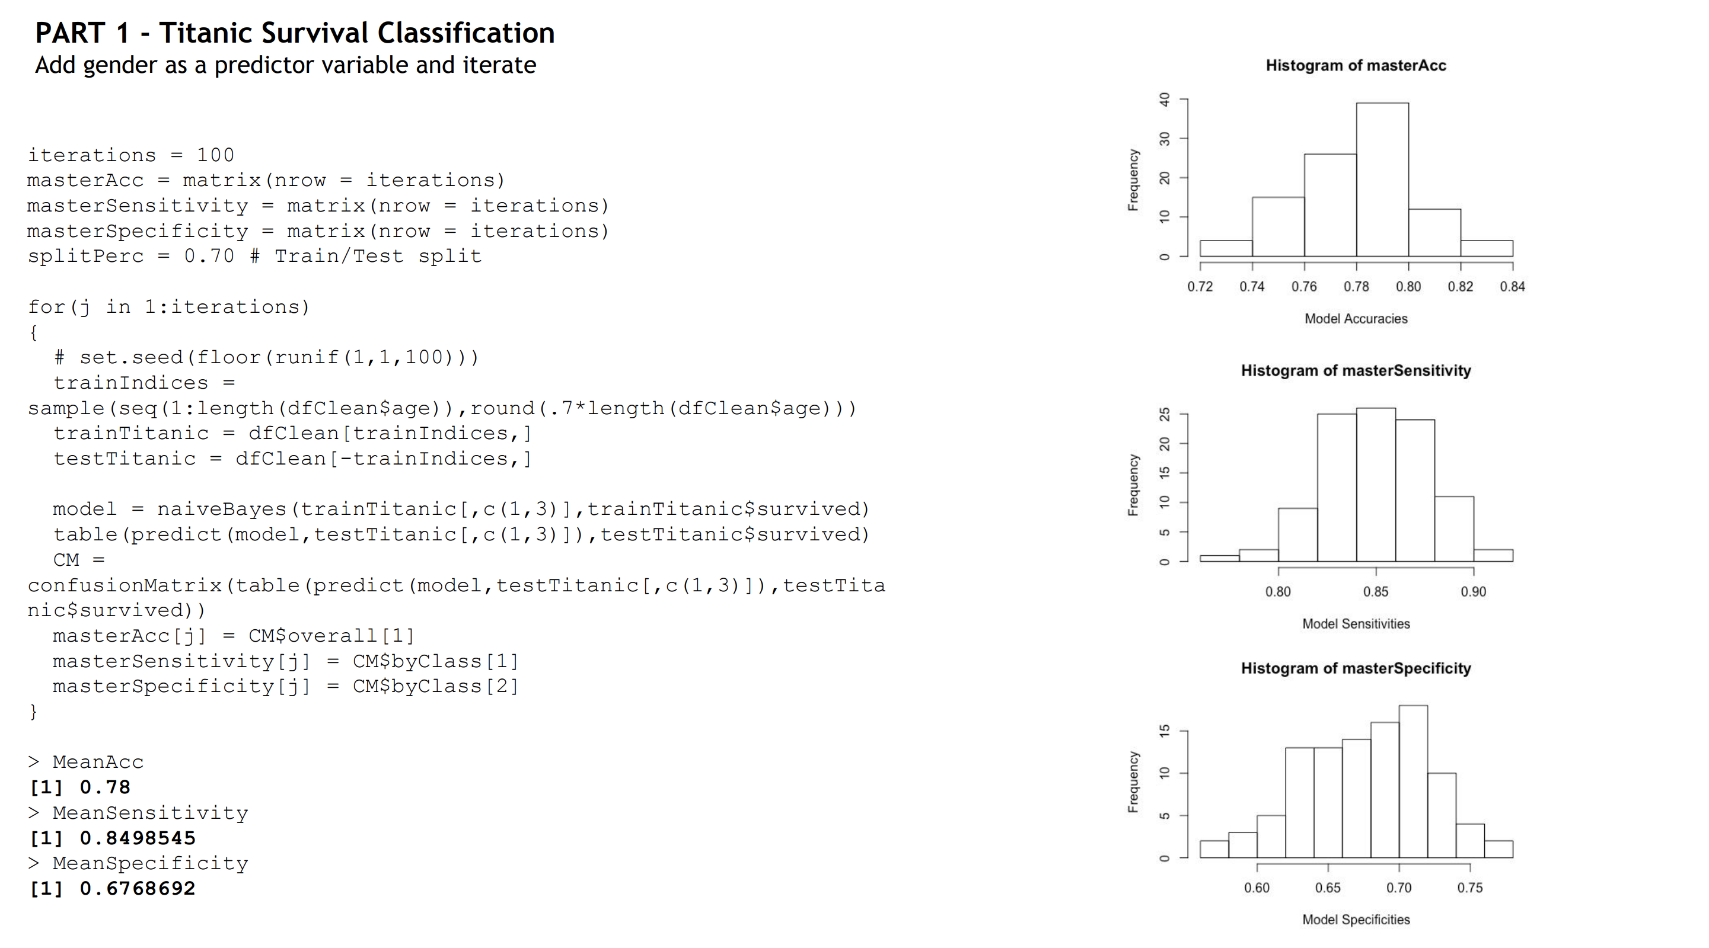

Slide 11
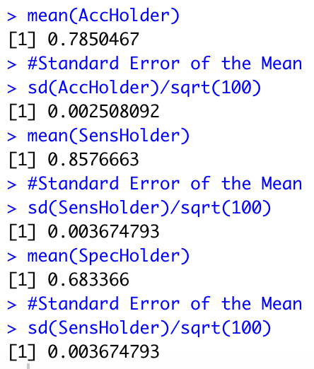
For Live Session: Part 1 (3-5 hours)
BONUS: Using the Male and Female KNN from the bonus of Unit 6, combine the two confusion matrices from the Male and Female KNN models to make one confusion matrix and find the accuracy, sensitivity and specificity based on that model. Compare this with the performance of your NB model. Do you prefer one over the other?
The code below will generate 100 different train/test splits and then take the average of 100 accuracies, sensitivities and specificities. Results are to the right.
# Bonus
AccHolder = numeric(100)
SensHolder = numeric(100)
SpecHolder = numeric(100)
for (seed in 1:100)
{
set.seed(seed)
trainIndices = sample(seq(1:length(titanicClean$Age)),round(.7*length(titanicClean$Age)))
trainTitanic = titanicClean[trainIndices,]
testTitanic = titanicClean[-trainIndices,]
#Male
trainTitanicMale = trainTitanic %>% filter(Sex == "male")
testTitanicMale = testTitanic %>% filter(Sex == "male")
classificationsMale = knn(trainTitanicMale[(!is.na(trainTitanicMale$Age) & !is.na(trainTitanicMale$Pclass)),c(3,6)],testTitanicMale[(!is.na(testTitanicMale$Age) & !is.na(testTitanicMale$Pclass)),c(3,6)],trainTitanicMale$Survived[(!is.na(trainTitanicMale$Age) & !is.na(trainTitanicMale$Pclass))], prob = TRUE, k = 11)
# Female
trainTitanicFemale = trainTitanic %>% filter(Sex == "female")
testTitanicFemale = testTitanic %>% filter(Sex == "female")
classificationsFemale = knn(trainTitanicFemale[(!is.na(trainTitanicFemale$Age) & !is.na(trainTitanicFemale$Pclass)),c(3,6)],testTitanicFemale[(!is.na(testTitanicFemale$Age) & !is.na(testTitanicFemale$Pclass)),c(3,6)],trainTitanicFemale$Survived[(!is.na(trainTitanicFemale$Age) & !is.na(trainTitanicFemale$Pclass))], prob = TRUE, k = 11)
classificationsMF = factor(c(classificationsMale,classificationsFemale), labels = c("No","Yes"))
testM = testTitanicMale[(!is.na(testTitanicMale$Age) & !is.na(testTitanicMale$Pclass)),]
testF = testTitanicFemale[(!is.na(testTitanicFemale$Age) & !is.na(testTitanicFemale$Pclass)),]
testMF = rbind(testM,testF)
table(classificationsMF,testMF$Survived[(!is.na(testMF$Age) & !is.na(testMF$Pclass))])
CM = confusionMatrix(table(classificationsMF,factor(testMF$Survived[(!is.na(testMF$Age) & !is.na(testMF$Pclass))],labels = c("No","Yes"))))
CM
AccHolder[seed] = CM$overall[1]
SensHolder[seed] = CM$byClass[1]
SpecHolder[seed] = CM$byClass[2]
}
mean(AccHolder)
#Standard Error of the Mean
sd(AccHolder)/sqrt(100)
mean(SensHolder)
#Standard Error of the Mean
sd(SensHolder)/sqrt(100)
mean(SpecHolder)
#Standard Error of the Mean
sd(SensHolder)/sqrt(100)

Slide 12
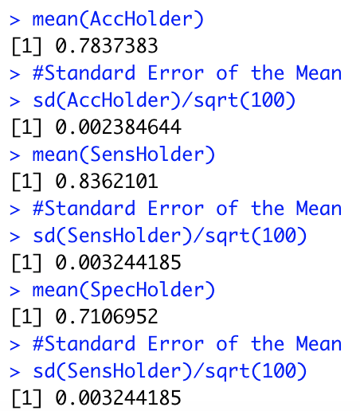
For Live Session: Part 1 (3-5 hours)
BONUS: Using the Male and Female KNN from the bonus of Unit 6, combine the two confusion matrices from the Male and Female KNN models to make one confusion matrix and find the accuracy, sensitivity and specificity based on that model. Compare this with the performance of your NB model. Do you prefer one over the other?
KNN k = 11
Naïve Bayes

Slide 13
For Live Session: Part 2 (1 – 3 hours)
a. For the full (multinomial) IRIS data (the iris dataset in R), do a 70-30 train/test cross validation and use sepal length and width as predictors. Generate 100 different train/test splits and calculate the average accuracy, sensitivity and specificity. Compare the average accuracy to that to the KNN model you used in Unit 6.

Slide 14
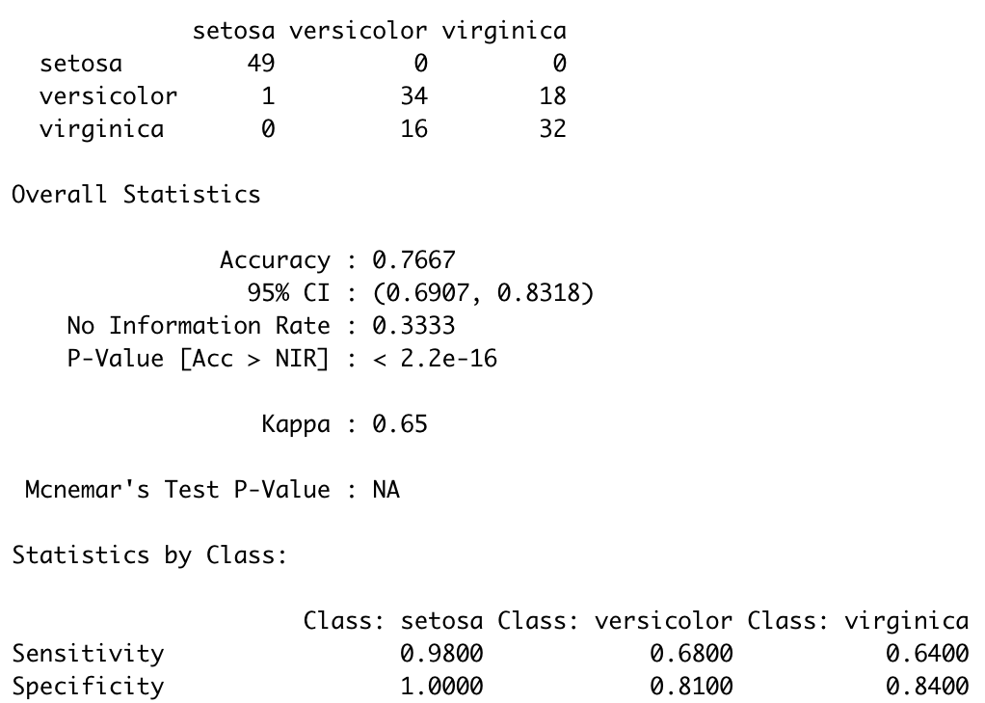
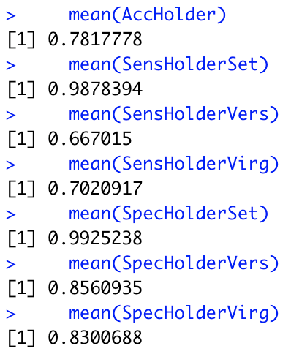
For Live Session: Part 2 (1 – 3 hours)
# Code for NB part
iterations = 100
AccHolder = numeric(100)
SensHolderSet = numeric(100)
SensHolderVers = numeric(100)
SensHolderVirg = numeric(100)
SpecHolderSet = numeric(100)
SpecHolderVers = numeric(100)
SpecHolderVirg = numeric(100)
for(seed in 1:iterations)
{
set.seed(seed)
trainIndices = sample(seq(1:150),round(.7*150))
irisTrain = iris[trainIndices,]
irisTest = iris[-trainIndices,]
model = naiveBayes(irisTrain[,c(1,2)],irisTrain[,5])
CM = confusionMatrix(table(irisTest$Species,predict(model,irisTest[,c(1,2)])))
AccHolder[seed] = CM$overall[1]
SensHolderSet[seed] = CM$byClass[,1][1]
SensHolderVers[seed] = CM$byClass[,1][2]
SensHolderVirg[seed] = CM$byClass[,1][3]
SpecHolderSet[seed] = CM$byClass[,2][1]
SpecHolderVers[seed] = CM$byClass[,2][2]
SpecHolderVirg[seed] = CM$byClass[,2][3]
}
mean(AccHolder)
mean(SensHolderSet)
mean(SensHolderVers)
mean(SensHolderVirg)
mean(SpecHolderSet)
mean(SpecHolderVers)
mean(SpecHolderVirg)
a. For the full (multinomial) IRIS data (the iris dataset in R), do a 70-30 train/test cross validation and use sepal length and width as predictors. Generate 100 different train/test splits and calculate the average accuracy, sensitivity and specificity. Compare the average accuracy to that to the KNN model you used in Unit 6.
My KNN model from Unit 6 (k = 20) with leave 1 out CV.
Average of 100 NB models

Slide 15
For Live Session: BONUS
Use the NYT News/Other Classifier code to analyze stories about Trump last month (search term “Trump”). We would like to build a classifier that will classify between news stories and other and we would like to compare two models: one that uses the headline and one that uses the snippet. Compare these two models based on sensitivity and specificity and provide at least one plot to help you visualize the results.

Slide 16
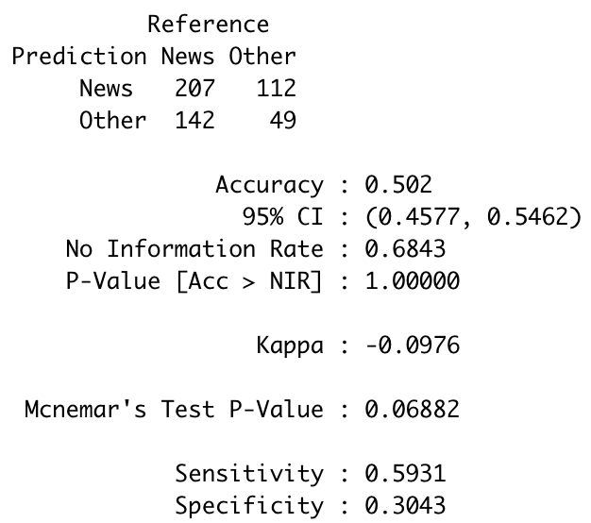
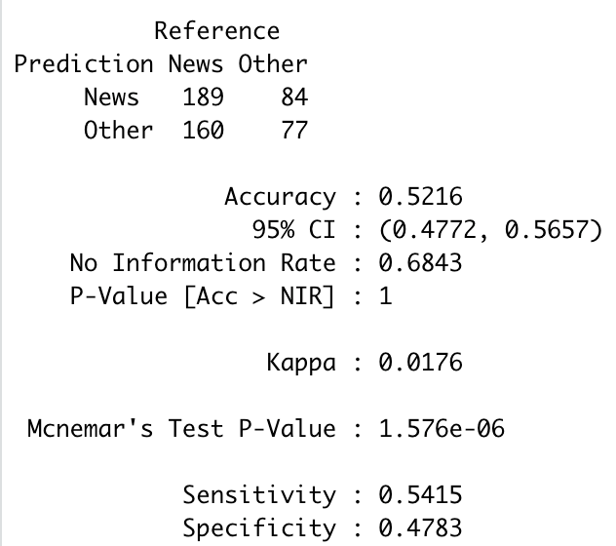
Naïve Bayes: News v. Other and Trump NYT Data
######################
# Loading the Data from the NYT API
# We will load from "Data+Science" and "Trump" searches.
# Data+Science Search
# term <- "Data+Science" # Need to use + to string together separate words
# begin_date <- "20180901"
# end_date <- "20190502"
# Trump Search
# term <- "Trump" # Need to use + to string together separate words
# begin_date <- "20190415"
# end_date <- "20190502"
######################
#NYT Example
library(tm) #text mining library provides the stopwords() function
library(tidyr)
library(plyr)
library(jsonlite)
library(dplyr)
library(tidyverse)
NYTIMES_KEY = "OG89fUubcS8FXofVrLA4dmIOHh5omiFa" #Your Key Here … get from NTY API website
# Let's set some parameters
term <- "Trump" # Need to use + to string together separate words
begin_date <- "20190901"
end_date <- "20190930"
baseurl <- paste0("http://api.nytimes.com/svc/search/v2/articlesearch.json?q=",term,
"&begin_date=",begin_date,"&end_date=",end_date,
"&facet_filter=true&api-key=",NYTIMES_KEY, sep="")
baseurl
initialQuery <- jsonlite::fromJSON(baseurl)
maxPages <- round((initialQuery$response$meta$hits[1] / 10)-1)
maxPages
pages <- list()
for(i in 0:maxPages){
nytSearch <- jsonlite::fromJSON(paste0(baseurl, "&page=", i), flatten = TRUE) %>% data.frame()
message("Retrieving page ", i)
pages[[i+1]] <- nytSearch
Sys.sleep(7)
}
allNYTSearch <- rbind_pages(pages)
#Segmentation
# Visualize coverage by section
allNYTSearch %>%
group_by(response.docs.type_of_material) %>%
dplyr::summarize(count=n()) %>%
mutate(percent = (count / sum(count))*100) %>%
ggplot() +
geom_bar(aes(y=percent, x=response.docs.type_of_material, fill=response.docs.type_of_material), stat = "identity") + coord_flip()
#Make another column of News versus Other ... The labels
allNYTSearch$NewsOrOther = ifelse(allNYTSearch$response.docs.type_of_material == "News","News","Other")
#There is an NA in NewsOrOther
# Visualize coverage of News or Other
allNYTSearch[!is.na(allNYTSearch$NewsOrOther),] %>%
group_by(NewsOrOther) %>%
dplyr::summarize(count=n()) %>%
mutate(percent = (count / sum(count))*100) %>%
ggplot() +
geom_bar(aes(y=percent, x=NewsOrOther, fill=NewsOrOther), stat = "identity") + coord_flip()
#Train and Test Split 70%/30%
set.seed(2)
trainInd = sample(seq(1,dim(allNYTSearch)[1],1),round(.7*dim(allNYTSearch)[1]))
allNYTSearchTrain = allNYTSearch[trainInd,]
allNYTSearchTest = allNYTSearch[-trainInd,]
#This function returns P(News | Keyword)
#P(News|KW) = P(KW|News)* P(News) / P(KW)
Pnews_word = function(key_word, trainingSet, alphaLaplace = 1, betaLaplace = 1) # alpha and beta are for laplace smoothing
{
trainingSet$response.docs.headline.main = unlist(str_replace_all(trainingSet$response.docs.snippet,"[^[:alnum:] ]", "")) #Take out all but alpha numeric characters from training headlines
#print(key_word)
NewsGroup = trainingSet[trainingSet$NewsOrOther == "News",]
OtherGroup = trainingSet[trainingSet$NewsOrOther == "Other",]
pNews = dim(NewsGroup)[1] / (dim(NewsGroup)[1] + dim(OtherGroup)[1])
pOther = 1 - pNews
pKWGivenNews = (length(str_which(NewsGroup$response.docs.snippet,regex(str_c("\\b",key_word,"\\b",sep=""),ignore.case = TRUE)))+alphaLaplace)/(dim(NewsGroup)[1]+betaLaplace)
pKWGivenOther = (length(str_which(OtherGroup$response.docs.snippet,regex(str_c("\\b",key_word,"\\b",sep=""),ignore.case = TRUE)))+alphaLaplace)/(dim(OtherGroup)[1]+betaLaplace)
pKW = length(str_which(trainingSet$response.docs.snippet,regex(str_c("\\b",key_word,"\\b",sep=""),ignore.case = TRUE)))/dim(trainingSet)[1]
pNewsGivenKW = pKWGivenNews*pNews/pKW
pOtherGivenKW = pKWGivenOther*pOther/pKW
return(pNewsGivenKW)
}
theScoreHolderNews = c()
theScoreHolderOther = c()
articleScoreNews = 0;
articleScoreOther = 0;
for (i in 1 : dim(allNYTSearchTest)[1]) #This loop iterates over the articles in the Test Set
{
articleScoreNews = 1;
articleScoreOther = 1;
#The [^[:alnum:] ] replaces all non alphanumeric characters with nulls.
theText = unlist(str_split(str_replace_all(allNYTSearchTest[i,]$response.docs.snippet,"[^[:alnum:] ]", ""), stringr::boundary("word"))) #Take out all but alpha numeric characters from search string ... theText holds each word in the headline as its own word.
# stopwords() #from package tm
wordsToTakeOut = stopwords()
# put word boundaries stopwords so that we don't detect partial words later
wordsToTakeOut = str_c(wordsToTakeOut,collapse = "\\b|\\b")
wordsToTakeOut = str_c("\\b",wordsToTakeOut,"\\b")
#wordsToTakeOut
importantWords = theText[!str_detect(theText,regex(wordsToTakeOut,ignore_case = TRUE))]
#importantWords
for(j in 1 : length(importantWords)) #This loop iterates over the important words in the headline
{
articleScoreNews = articleScoreNews * Pnews_word(importantWords[j],allNYTSearchTrain)
articleScoreOther = articleScoreOther * (1 - Pnews_word(importantWords[j],allNYTSearchTrain))
}
theScoreHolderNews[i] = articleScoreNews
theScoreHolderOther[i] = articleScoreOther
}
# Classify the aricle as News or Other based on a given piece of information from the article.
allNYTSearchTest$Classified = ifelse(theScoreHolderNews > theScoreHolderOther,"News","Other")
#Confusion Matrix
table(allNYTSearchTest$Classified,allNYTSearchTest$NewsOrOther) #Actual in Columns
confusionMatrix(factor(allNYTSearchTest$Classified),factor(allNYTSearchTest$NewsOrOther))
######################
# Loading the Data from the NYT API
# We will load from "Data+Science" and "Trump" searches.
# Data+Science Search
# term <- "Data+Science" # Need to use + to string together separate words
# begin_date <- "20180901"
# end_date <- "20190502"
# Trump Search
# term <- "Trump" # Need to use + to string together separate words
# begin_date <- "20190415"
# end_date <- "20190502"
######################
#NYT Example
library(tm) #text mining library provides the stopwords() function
library(tidyr)
library(plyr)
library(jsonlite)
library(dplyr)
library(tidyverse)
NYTIMES_KEY = "OG89fUubcS8FXofVrLA4dmIOHh5omiFa" #Your Key Here … get from NTY API website
# Let's set some parameters
term <- "Trump" # Need to use + to string together separate words
begin_date <- "20190901"
end_date <- "20190930"
baseurl <- paste0("http://api.nytimes.com/svc/search/v2/articlesearch.json?q=",term,
"&begin_date=",begin_date,"&end_date=",end_date,
"&facet_filter=true&api-key=",NYTIMES_KEY, sep="")
baseurl
initialQuery <- jsonlite::fromJSON(baseurl)
maxPages <- round((initialQuery$response$meta$hits[1] / 10)-1)
maxPages
pages <- list()
for(i in 0:maxPages){
nytSearch <- jsonlite::fromJSON(paste0(baseurl, "&page=", i), flatten = TRUE) %>% data.frame()
message("Retrieving page ", i)
pages[[i+1]] <- nytSearch
Sys.sleep(7)
}
allNYTSearch <- rbind_pages(pages)
#Segmentation
# Visualize coverage by section
allNYTSearch %>%
group_by(response.docs.type_of_material) %>%
dplyr::summarize(count=n()) %>%
mutate(percent = (count / sum(count))*100) %>%
ggplot() +
geom_bar(aes(y=percent, x=response.docs.type_of_material, fill=response.docs.type_of_material), stat = "identity") + coord_flip()
#Make another column of News versus Other ... The labels
allNYTSearch$NewsOrOther = ifelse(allNYTSearch$response.docs.type_of_material == "News","News","Other")
#There is an NA in NewsOrOther
# Visualize coverage of News or Other
allNYTSearch[!is.na(allNYTSearch$NewsOrOther),] %>%
group_by(NewsOrOther) %>%
dplyr::summarize(count=n()) %>%
mutate(percent = (count / sum(count))*100) %>%
ggplot() +
geom_bar(aes(y=percent, x=NewsOrOther, fill=NewsOrOther), stat = "identity") + coord_flip()
#Train and Test Split 70%/30%
set.seed(2)
trainInd = sample(seq(1,dim(allNYTSearch)[1],1),round(.7*dim(allNYTSearch)[1]))
allNYTSearchTrain = allNYTSearch[trainInd,]
allNYTSearchTest = allNYTSearch[-trainInd,]
#This function returns P(News | Keyword)
#P(News|KW) = P(KW|News)* P(News) / P(KW)
Pnews_word = function(key_word, trainingSet, alphaLaplace = 1, betaLaplace = 1) # alpha and beta are for laplace smoothing
{
trainingSet$response.docs.headline.main = unlist(str_replace_all(trainingSet$response.docs.snippet,"[^[:alnum:] ]", "")) #Take out all but alpha numeric characters from training headlines
#print(key_word)
NewsGroup = trainingSet[trainingSet$NewsOrOther == "News",]
OtherGroup = trainingSet[trainingSet$NewsOrOther == "Other",]
pNews = dim(NewsGroup)[1] / (dim(NewsGroup)[1] + dim(OtherGroup)[1])
pOther = 1 - pNews
pKWGivenNews = (length(str_which(NewsGroup$response.docs.snippet,regex(str_c("\\b",key_word,"\\b",sep=""),ignore.case = TRUE)))+alphaLaplace)/(dim(NewsGroup)[1]+betaLaplace)
pKWGivenOther = (length(str_which(OtherGroup$response.docs.snippet,regex(str_c("\\b",key_word,"\\b",sep=""),ignore.case = TRUE)))+alphaLaplace)/(dim(OtherGroup)[1]+betaLaplace)
pKW = length(str_which(trainingSet$response.docs.snippet,regex(str_c("\\b",key_word,"\\b",sep=""),ignore.case = TRUE)))/dim(trainingSet)[1]
pNewsGivenKW = pKWGivenNews*pNews/pKW
pOtherGivenKW = pKWGivenOther*pOther/pKW
return(pNewsGivenKW)
}
theScoreHolderNews = c()
theScoreHolderOther = c()
articleScoreNews = 0;
articleScoreOther = 0;
for (i in 1 : dim(allNYTSearchTest)[1]) #This loop iterates over the articles in the Test Set
{
articleScoreNews = 1;
articleScoreOther = 1;
#The [^[:alnum:] ] replaces all non alphanumeric characters with nulls.
theText = unlist(str_split(str_replace_all(allNYTSearchTest[i,]$response.docs.snippet,"[^[:alnum:] ]", ""), stringr::boundary("word"))) #Take out all but alpha numeric characters from search string ... theText holds each word in the headline as its own word.
# stopwords() #from package tm
wordsToTakeOut = stopwords()
# put word boundaries stopwords so that we don't detect partial words later
wordsToTakeOut = str_c(wordsToTakeOut,collapse = "\\b|\\b")
wordsToTakeOut = str_c("\\b",wordsToTakeOut,"\\b")
#wordsToTakeOut
importantWords = theText[!str_detect(theText,regex(wordsToTakeOut,ignore_case = TRUE))]
#importantWords
for(j in 1 : length(importantWords)) #This loop iterates over the important words in the headline
{
articleScoreNews = articleScoreNews * Pnews_word(importantWords[j],allNYTSearchTrain)
articleScoreOther = articleScoreOther * (1 - Pnews_word(importantWords[j],allNYTSearchTrain))
}
theScoreHolderNews[i] = articleScoreNews
theScoreHolderOther[i] = articleScoreOther
}
# Classify the aricle as News or Other based on a given piece of information from the article.
allNYTSearchTest$Classified = ifelse(theScoreHolderNews > theScoreHolderOther,"News","Other")
#Confusion Matrix
table(allNYTSearchTest$Classified,allNYTSearchTest$NewsOrOther) #Actual in Columns
confusionMatrix(factor(allNYTSearchTest$Classified),factor(allNYTSearchTest$NewsOrOther))
######################
# Loading the Data from the NYT API
# We will load from "Data+Science" and "Trump" searches.
# Data+Science Search
# term <- "Data+Science" # Need to use + to string together separate words
# begin_date <- "20180901"
# end_date <- "20190502"
# Trump Search
# term <- "Trump" # Need to use + to string together separate words
# begin_date <- "20190415"
# end_date <- "20190502"
######################
#NYT Example
library(tm) #text mining library provides the stopwords() function
library(tidyr)
library(plyr)
library(jsonlite)
library(dplyr)
library(tidyverse)
NYTIMES_KEY = "OG89fUubcS8FXofVrLA4dmIOHh5omiFa" #Your Key Here … get from NTY API website
# Let's set some parameters
term <- "Trump" # Need to use + to string together separate words
begin_date <- "20190901"
end_date <- "20190930"
baseurl <- paste0("http://api.nytimes.com/svc/search/v2/articlesearch.json?q=",term,
"&begin_date=",begin_date,"&end_date=",end_date,
"&facet_filter=true&api-key=",NYTIMES_KEY, sep="")
baseurl
initialQuery <- jsonlite::fromJSON(baseurl)
maxPages <- round((initialQuery$response$meta$hits[1] / 10)-1)
maxPages
pages <- list()
for(i in 0:maxPages){
nytSearch <- jsonlite::fromJSON(paste0(baseurl, "&page=", i), flatten = TRUE) %>% data.frame()
message("Retrieving page ", i)
pages[[i+1]] <- nytSearch
Sys.sleep(7)
}
allNYTSearch <- rbind_pages(pages)
#Segmentation
# Visualize coverage by section
allNYTSearch %>%
group_by(response.docs.type_of_material) %>%
dplyr::summarize(count=n()) %>%
mutate(percent = (count / sum(count))*100) %>%
ggplot() +
geom_bar(aes(y=percent, x=response.docs.type_of_material, fill=response.docs.type_of_material), stat = "identity") + coord_flip()
#Make another column of News versus Other ... The labels
allNYTSearch$NewsOrOther = ifelse(allNYTSearch$response.docs.type_of_material == "News","News","Other")
#There is an NA in NewsOrOther
# Visualize coverage of News or Other
allNYTSearch[!is.na(allNYTSearch$NewsOrOther),] %>%
group_by(NewsOrOther) %>%
dplyr::summarize(count=n()) %>%
mutate(percent = (count / sum(count))*100) %>%
ggplot() +
geom_bar(aes(y=percent, x=NewsOrOther, fill=NewsOrOther), stat = "identity") + coord_flip()
#Train and Test Split 70%/30%
set.seed(2)
trainInd = sample(seq(1,dim(allNYTSearch)[1],1),round(.7*dim(allNYTSearch)[1]))
allNYTSearchTrain = allNYTSearch[trainInd,]
allNYTSearchTest = allNYTSearch[-trainInd,]
#This function returns P(News | Keyword)
#P(News|KW) = P(KW|News)* P(News) / P(KW)
Pnews_word = function(key_word, trainingSet, alphaLaplace = 1, betaLaplace = 1) # alpha and beta are for laplace smoothing
{
trainingSet$response.docs.headline.main = unlist(str_replace_all(trainingSet$response.docs.snippet,"[^[:alnum:] ]", "")) #Take out all but alpha numeric characters from training headlines
#print(key_word)
NewsGroup = trainingSet[trainingSet$NewsOrOther == "News",]
OtherGroup = trainingSet[trainingSet$NewsOrOther == "Other",]
pNews = dim(NewsGroup)[1] / (dim(NewsGroup)[1] + dim(OtherGroup)[1])
pOther = 1 - pNews
pKWGivenNews = (length(str_which(NewsGroup$response.docs.snippet,regex(str_c("\\b",key_word,"\\b",sep=""),ignore.case = TRUE)))+alphaLaplace)/(dim(NewsGroup)[1]+betaLaplace)
pKWGivenOther = (length(str_which(OtherGroup$response.docs.snippet,regex(str_c("\\b",key_word,"\\b",sep=""),ignore.case = TRUE)))+alphaLaplace)/(dim(OtherGroup)[1]+betaLaplace)
pKW = length(str_which(trainingSet$response.docs.snippet,regex(str_c("\\b",key_word,"\\b",sep=""),ignore.case = TRUE)))/dim(trainingSet)[1]
pNewsGivenKW = pKWGivenNews*pNews/pKW
pOtherGivenKW = pKWGivenOther*pOther/pKW
return(pNewsGivenKW)
}
theScoreHolderNews = c()
theScoreHolderOther = c()
articleScoreNews = 0;
articleScoreOther = 0;
for (i in 1 : dim(allNYTSearchTest)[1]) #This loop iterates over the articles in the Test Set
{
articleScoreNews = 1;
articleScoreOther = 1;
#The [^[:alnum:] ] replaces all non alphanumeric characters with nulls.
theText = unlist(str_split(str_replace_all(allNYTSearchTest[i,]$response.docs.snippet,"[^[:alnum:] ]", ""), stringr::boundary("word"))) #Take out all but alpha numeric characters from search string ... theText holds each word in the headline as its own word.
# stopwords() #from package tm
wordsToTakeOut = stopwords()
# put word boundaries stopwords so that we don't detect partial words later
wordsToTakeOut = str_c(wordsToTakeOut,collapse = "\\b|\\b")
wordsToTakeOut = str_c("\\b",wordsToTakeOut,"\\b")
#wordsToTakeOut
importantWords = theText[!str_detect(theText,regex(wordsToTakeOut,ignore_case = TRUE))]
#importantWords
for(j in 1 : length(importantWords)) #This loop iterates over the important words in the headline
{
articleScoreNews = articleScoreNews * Pnews_word(importantWords[j],allNYTSearchTrain)
articleScoreOther = articleScoreOther * (1 - Pnews_word(importantWords[j],allNYTSearchTrain))
}
theScoreHolderNews[i] = articleScoreNews
theScoreHolderOther[i] = articleScoreOther
}
# Classify the aricle as News or Other based on a given piece of information from the article.
allNYTSearchTest$Classified = ifelse(theScoreHolderNews > theScoreHolderOther,"News","Other")
#Confusion Matrix
table(allNYTSearchTest$Classified,allNYTSearchTest$NewsOrOther) #Actual in Columns
confusionMatrix(factor(allNYTSearchTest$Classified),factor(allNYTSearchTest$NewsOrOther))
With Headline
With Snippet

